Slide 1
Resume Parser using Python and NLP

Slide 2
OBJECTIVE OF THE PROJECT
The goal of this project is to develop a resume parser, a tool that can automatically extract relevant information from resumes using python and NLP techniques.

Slide 3
Tools used
Python
Numpy
Pandas
Re(regular expression)
NLTK(natural language toolkit)
Spacy
PyPDF2

Slide 4
introduction
The script begins by importing necessary libraries such as numpy, pandas, re, nltk, spacy, and modules from PyPDF2.
Script processes each resume file one by one.
In the each file, it reads the text content using the pdftotext function, and then extracts various pieces of information using the extraction functions defined earlier
After processing all resumes, the extracted information is converted into a pandas dataframe and then saved into a CSV file named output.Csv.
The script reads the csv file back into a dataframe and applies some data cleaning operations. In particular, it replaces non-ascii characters in the 'education' column with spaces.
Finally, it prints the first few rows of the dataframe to display the extracted information.

Slide 5
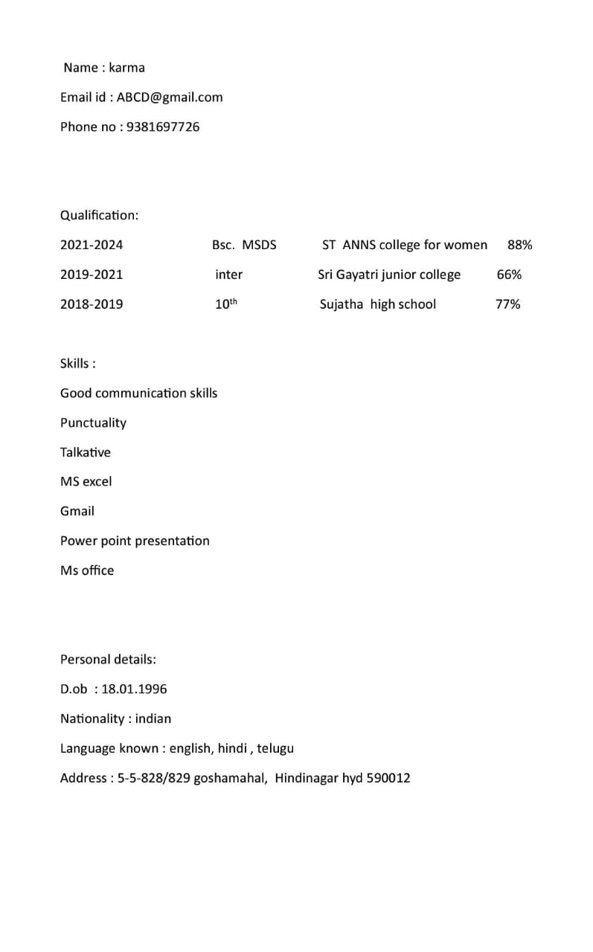
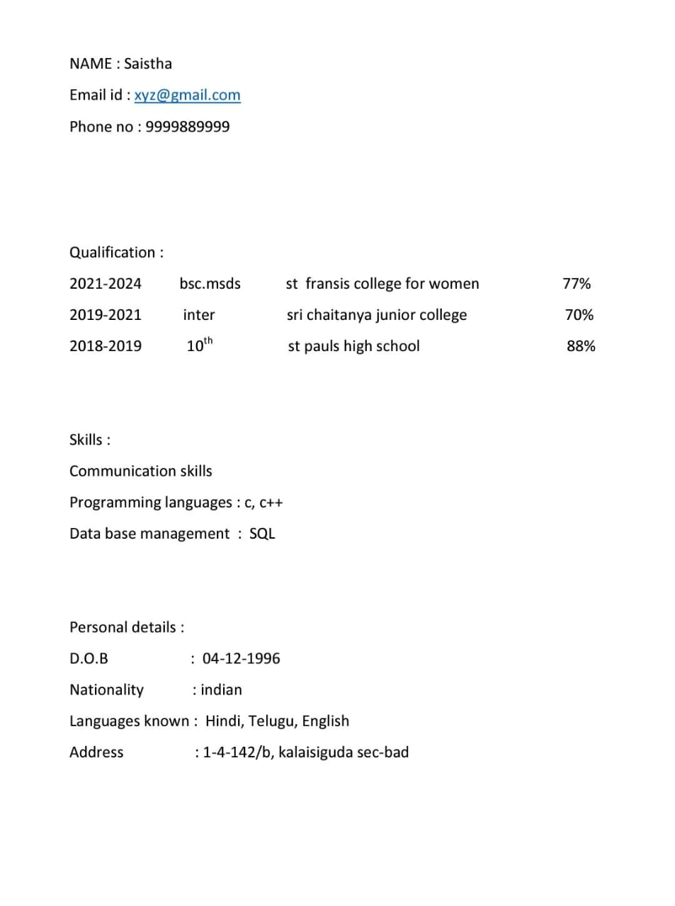
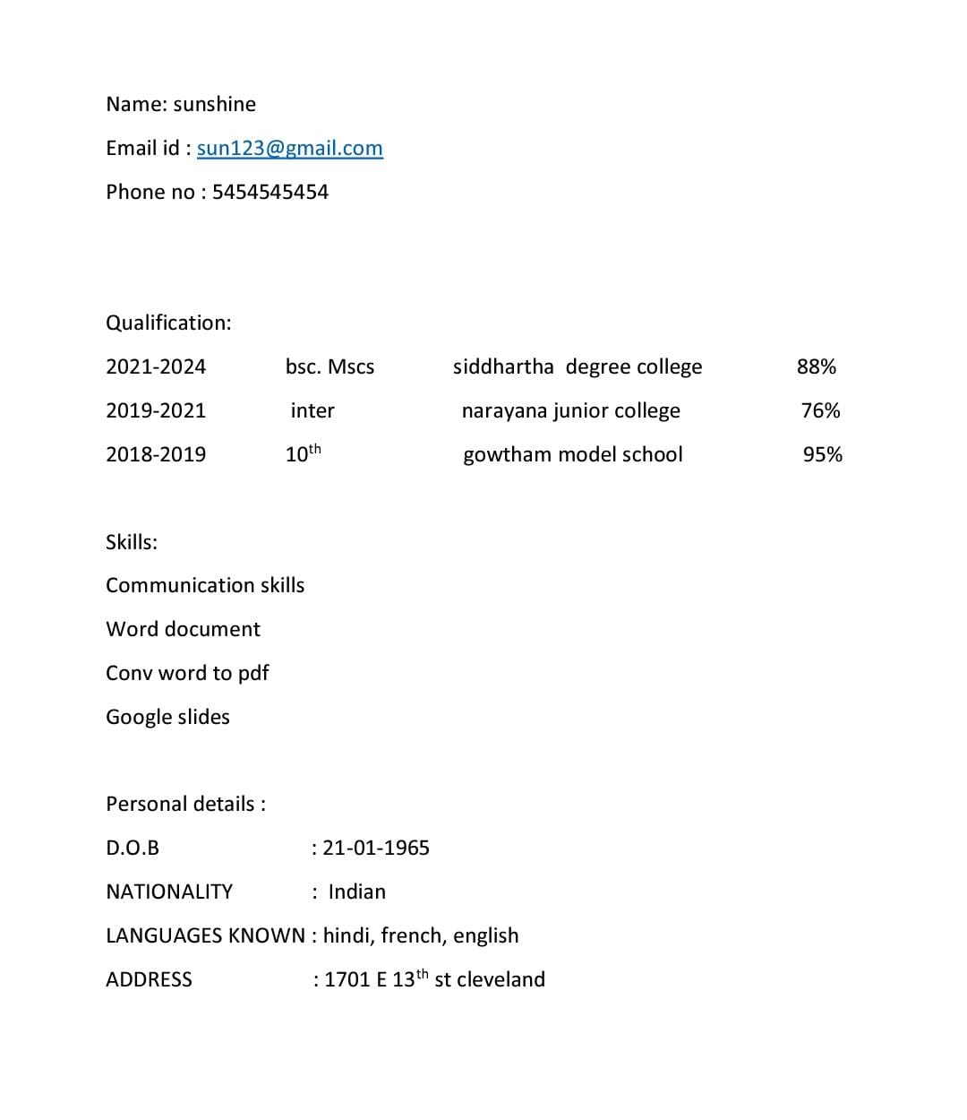
Data collection
We have gathered a diverse set of resumes to train and test the parser.

Slide 6
Data cleaning
First,we extracted the information like extract_name,extract_email_address(),extract_phone_number(),extract_qualification(), and extract_skills() from the textv of each resume.
The re.Sub() function is used to remove the non-ancii characters and ensures the qualification text contains only ansii characters.
After processing all resumes,the extracted information is covered into a pandas dataframe and the saved into a csv file named output.Csv
Then it creates a data structure where each resume's information is stored as a separate record or row.

Slide 7
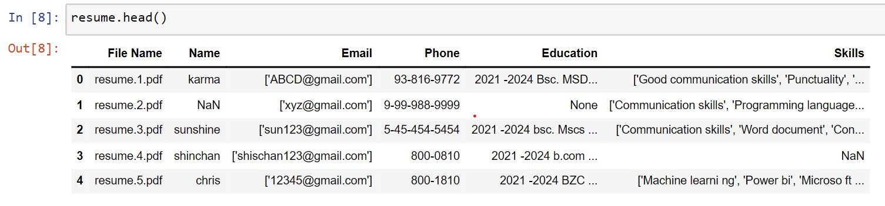
output
This this the output of the extacted information

Slide 8
Thank you!!
seetha vijaya

